Slide 1

DEPARTMENT OF COMPUTER SCIENCE AND ENGINEERING MAJOR PROJECT ON BLIND ASSESSMENT INTELLIGENCE DEVICE
Guide
K. Ashok sir
Coordinator
G. Srikanth sir
BATCH NO:19PB18
G. Swetha(19P61A0573)
J. Maithri(19P61A0590)
K. Jeevana(19P61A05B5)
NO:19PB18 CH NO:19PB18

Slide 2
PROBLEM STATEMENT
To build an application, which will improve the ability of visually impaired people in their day-to-day life.

Slide 3
OBJECTIVE
To Aid the visually impaired to locate, assess control actions and objects around them. To help navigate and scan objects for easy identification.

Slide 4
AIM OF THE PROJECT
Visual Impairment makes the person depend on another person for all their works and daily chores. This project is aimed to help blind people and eliminate their pain. Designing automated navigation system for blind people.

Slide 5
EXISTING SYSTEM
The existing approaches suffer from the drawbacks such as the requirement of several sensors, the system not being portable, and fail to do real-time processing. In the proposed system, sincere attempts are made to address a few of these issues This system has used traditional instruments that have been supportive of the visually impaired over the years but take time to get used to and do not go well with the current generation’s technological improvement giving rise to issues that the proposed system overcomes.

Slide 6
PROPOSED SYSTEM
First, the user starts the device and captures the image of the surrounding in front of him or of the object in front of him that he wants to identify The system digitizes and stores the captured image in the memory. It is then used to detect objects in other images. This image will be processed by using OpenCV and YOLOV3 algorithms. The OpenCV library contains many Image Processing algorithms and YOLOV3 has the power to compare the input image with millions of other images using Microsoft’s COCO Dataset.

Slide 7
SCOPE OF THE PROJECT
Our project covers visually impaired or blind people as a scope of the project. Recently, there has been a lot of interest in blind assisting technology, like speech recognition for people with disabilities, all over the world.

Slide 8
SOFTWARE AND HARDWARE REQUIREMENTS
SOFTWARE REQUIREMENTS
Software : YOLOV3,GTTS.
Operating System : Windows 10
Programming Language : Python
DataSet : COCO DATASET
HARDWARE REQUIREMENTS
Device : Laptop/Smartphone
Processor : Intel i5

Slide 9
ALGORITHM YOLO OBJECT DETECTION AND GTTS:
You only look once.
YOLOv3 is a real-time object detection.
It detects the object.
From COCO DATASET it will train and detect the class of the object.
With the help of voice modules the class of the object will be converted into default voice notes.
Default voice notes will be sent to the blind victims for their assistance.

Slide 10
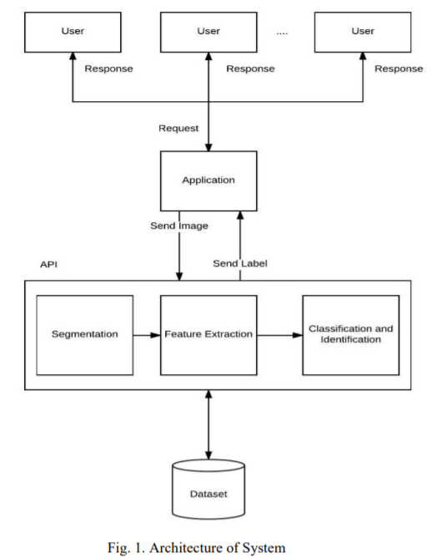
ARCHITECTURE:
Fig: The Architecture of the Blind AID system

Slide 11
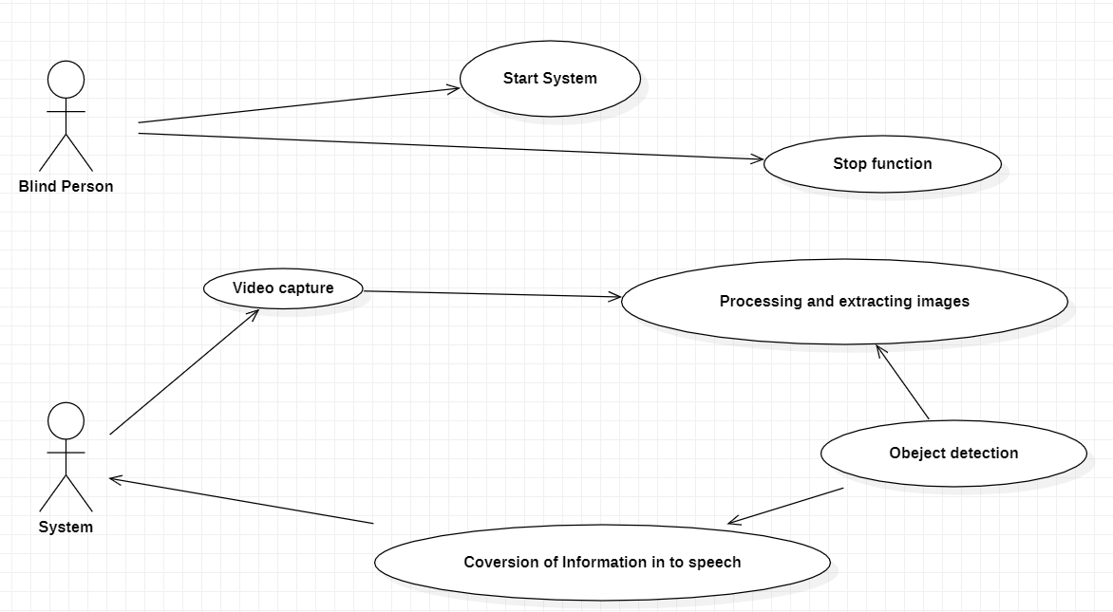
UML DIAGRAMS USE CASE DIAGRAM:

Slide 12
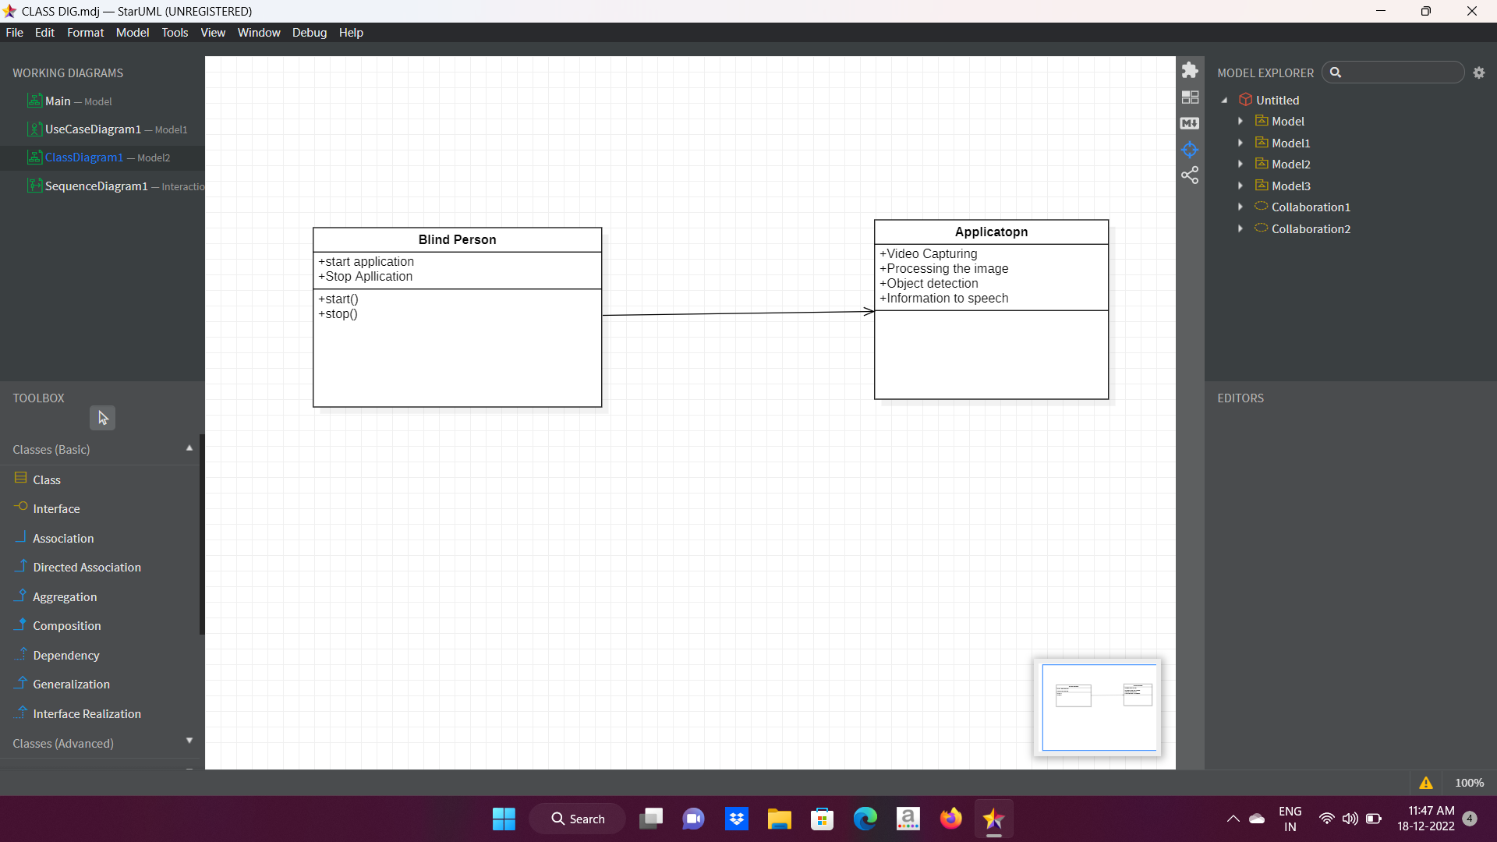
CLASS DIAGRAM:

Slide 13
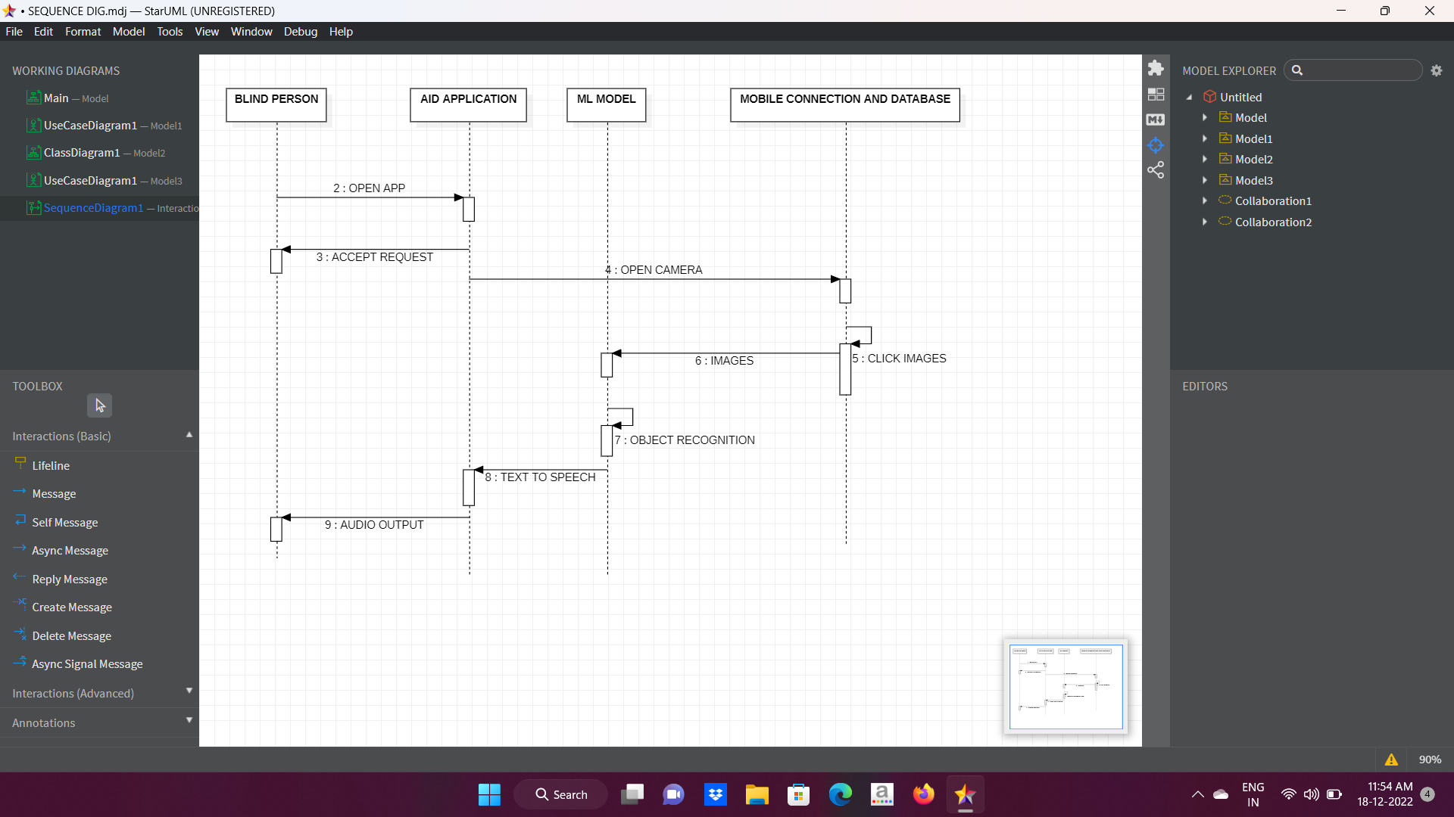
SEQUENCE DIAGRAM:

Slide 14
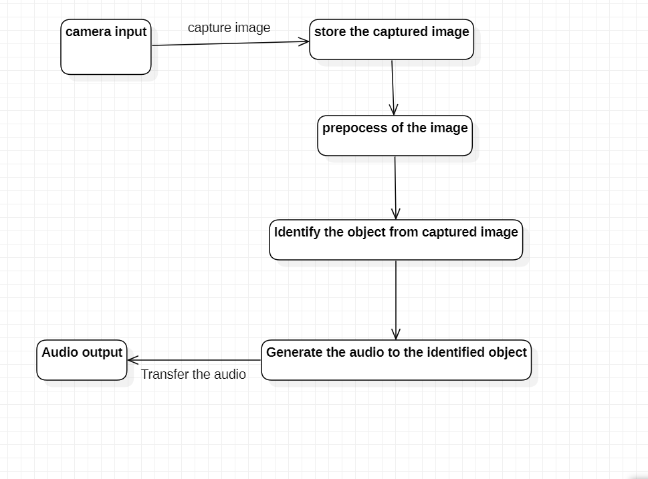
ACTIVITY DIAGRAM:

Slide 15
DATASET:
The MS COCO (Microsoft Common Objects in Context) dataset is a large-scale object detection Dataset. The first version of the MS COCO dataset was released in 2014. It contains 164K images split into training (83K), validation (41%), and test (41K) sets. In 2015 additional test set of 81K images was released, including all the previous test images and 40K new images. 21 Based on community feedback, in 2017 the maining validation split was changed from 83K/41K to 118K/5K. The new split uses the same images and annotations. The 2017 test set is a subset of 41K images of the 2015 test set. Additionally, the 2017 release contains a new unannotated dataset of 123K images.

Slide 16
DATASET:
person, bicycle, car, motorcycle, airplane, bun, train, truck, boat, traffic light, fire hydrant, stop sign, parking, meter, bench, bird, cat, dog, horse, sheep, cow, elephant, bear, zebra, giraffe, backpack, umbrella, handbag, tie, suitcase, frisbee, skis, snowboard, sports ball, kite, baseball bat, baseball glove, skateboard, surfboard, tennis racket, bottle, wine glass, cup, fork, knife, Spoon, banana, apple, sandwich, orange, broccoli, carrot, hot dog, pizza, donut, cake, chair, couch, potted plant, bed, dining table, toilet, tv, laptop, mouse, remote, keyboard, cell phone, Microwave, oven, toaster, sink, refrigerator, book, clock, vase, scissors, teddy bear, hair drier, toothbrush.

Slide 17
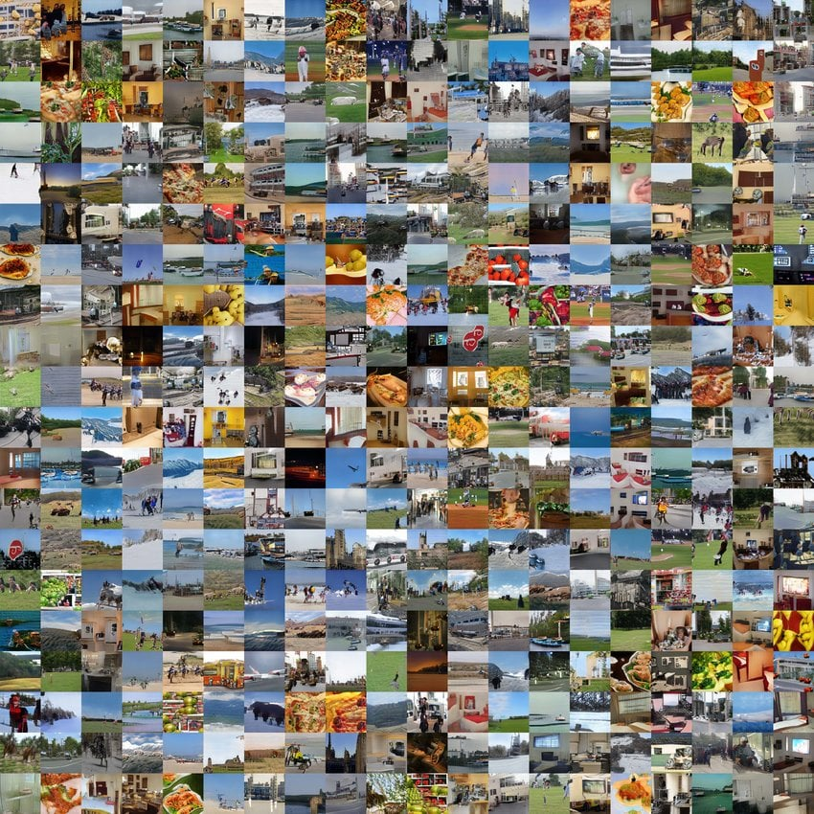
EXAMPLE:

Slide 18
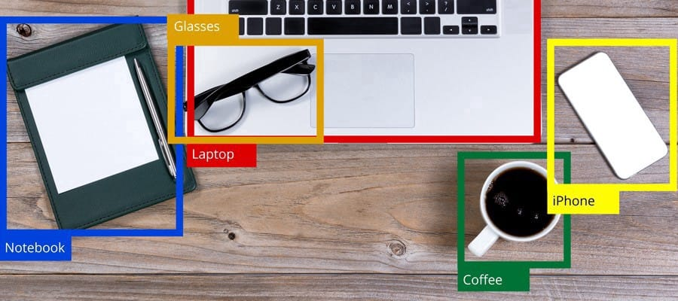

Slide 19
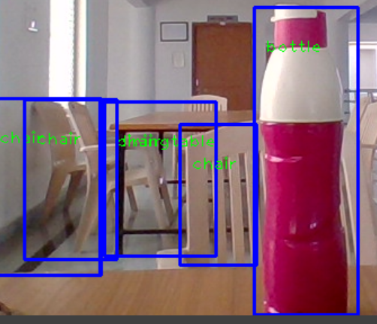
SAMPLE OUTPUTS

Slide 20
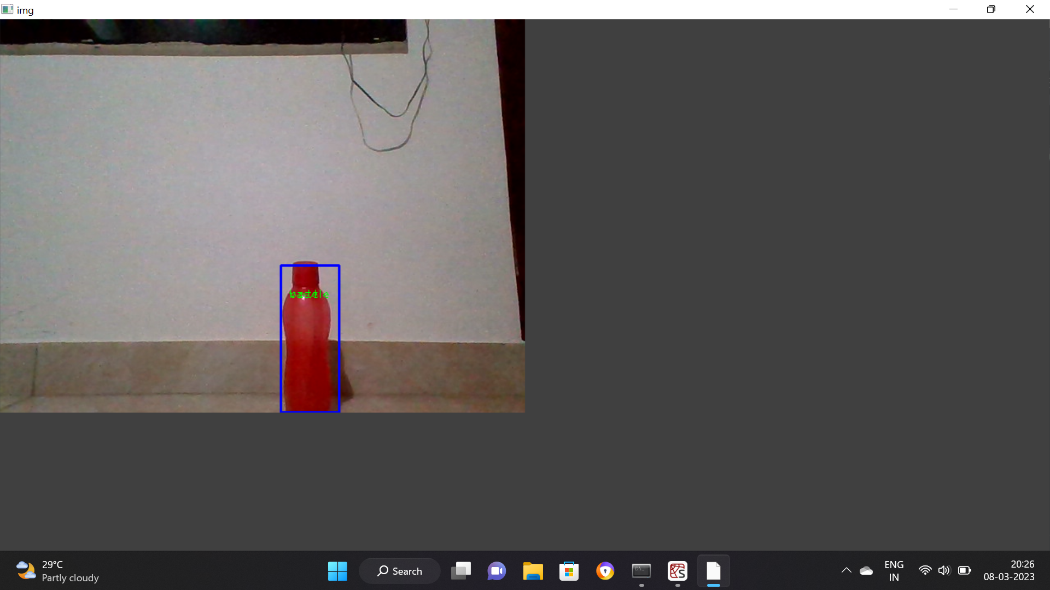

Slide 21
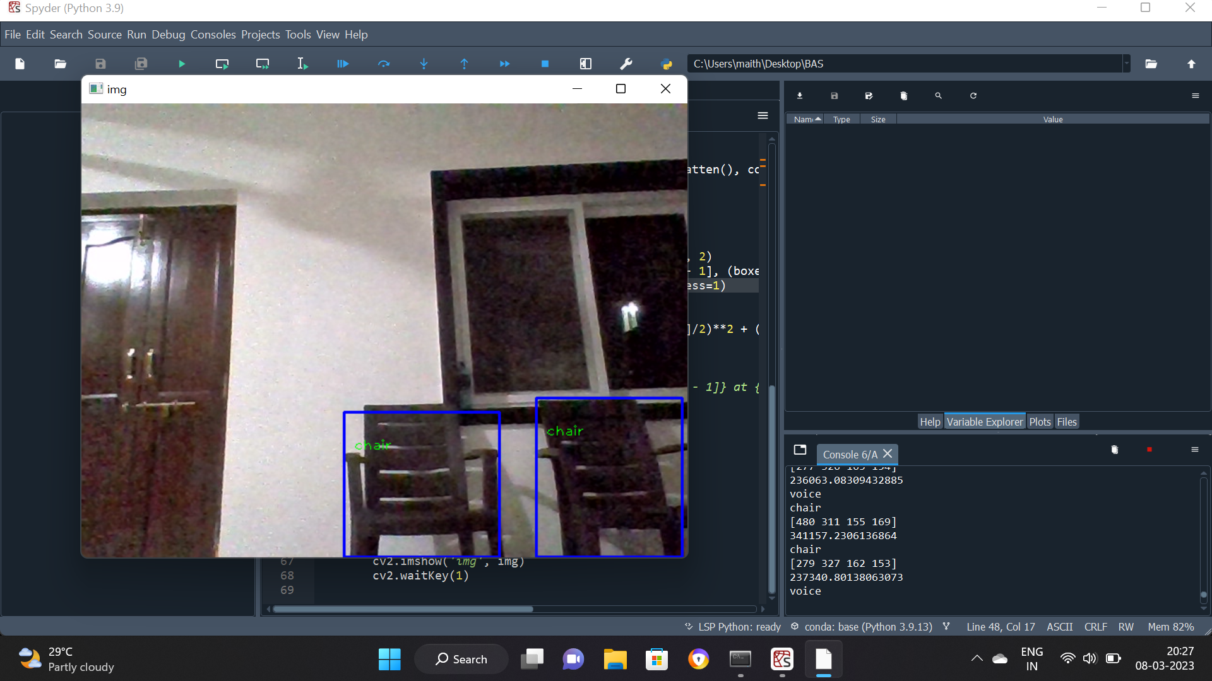

Slide 22
CONCLUSION:
Artificial intelligence Technology is advancing rapidly every day, improving other aspects of the lives of people with disabilities, autism, the elderly, the visually impaired and other people in need of care. To help these people, machines must understand the senses on their own and have the empathy to solve problems. Our artificial intelligence researchers and experts are trying to make the devices or machines real. There is no doubt that in the coming decades the machines we visit will readily understand the human senses and solve problems accordingly.
The Android App named, Blind-Aid has been developed and this App satisfies all proposed requirements. The App is highly scalable and user-friendly. To help blind people see the world with your "ears".

Slide 23
REFERENCE
[1] E. Foulke, “The perceptual basis for mobility”, AFB Research Bulletin, Vol. 23, pp. 1-8, 1971. [2] A. Colenbrander, “Visual standards: aspects and ranges of vision loss,” Report prepared for the International Council of Ophthalmology at the 29th International Congress of Ophthalmology, Sydney, Australia, 33 pp., 2002.
[2] Anonymous, “Visual impairment and blindness,” Fact Sheet No. 282. World Health Organization, Geneva, Switzerland[Online].Available http://www.who.int/mediacentr e/factsheets/ fs282/en
[3] J.A. Brabyn, “New developments in mobility and orientation aids for the blind”, IEEE Transactions on Biomedical Engineering, Vol. BME-29, No. 4, pp. 285-289, 1982.
[4] L. Kay, “An ultrasonic sensing probe as a mobility aid for the blind,” Ultrasonics, Vol. 2, Issue 2, pp. 53-59, April-June 1964.

Slide 24
[5] Ashok, A., & Vijayakumar, V. (2019). An IoT based assistive device for visually impaired using AI. 2019 International Conference on Electrical, Communication, and Computing (ICECCO), 1-5. doi: 10.1109/ICECCO47504.2019.9005975.
[6] Chakraborty, A., Das, S., Dutta, A., & Das, S. (2018). An AI-based assistive device for the visually impaired. 2018 Second International Conference on Electronics, Communication and Aerospace Technology (ICECA), 1009-1012. doi: 10.1109/ICECA.2018.8475467.
[7] Dutta, A., Das, S., Chakraborty, A., & Das, S. (2018). Design of an AI-based assistive device for visually impaired people. 2018 International Conference on Computing, Communication, and Intelligent Systems (ICCCIS), 365-369. doi: 10.1109/ICCCIS.2018.8669705.

Slide 25
[8] Hamzah, A., Lasebae, A., & Er, M. J. (2020). Intelligent wearable device for blind and visually impaired people. IEEE Access, 8, 158364-158376. doi: 10.1109/ACCESS.2020.3011302.
[9] Liu, J., Zhang, M., Yang, J., & Li, B. (2018). Intelligent wearable device for visually impaired people using computer vision and deep learning. IEEE Access, 6, 59211-59220. doi: 10.1109/ACCESS.2018.2877459.

Slide 26
THANK YOU

